Slide 2
Safe Harbor
This presentation and the accompanying slides (the “Presentation”), which has been prepared by iStreet Network Limited (the “Company”), solely for information purposes and do not constitute any offer, recommendation or invitation to purchase or subscribe for any securities, and shall not form the basis or be relied on in connection with any contract or binding commitment whatsoever. No offering of securities of the Company will be made except by means of a statutory offering document containing detailed information about the Company.
Our actual results may differ materially from those included in this presentation for a variety of reasons, including, but not limited to - changes in political, business, and economic conditions; foreign exchange rate fluctuations; the impact and integration of recent and future acquisitions; our need to successfully react to the increasing importance of mobile payments and mobile commerce and the social aspect of commerce; an increasingly competitive environment for our businesses; the complexity of managing an increasingly large and growing enterprise, with a broad range of businesses; our need to manage regulatory, tax and litigation risks (including risks); and our need to timely upgrade and develop our systems, infrastructure, and customer service capabilities at reasonable cost while maintaining site stability and performance and adding new products and features.
This presentation also contains product demonstrations (or reference to such new products), some of which are conceptual and may not be developed or launched in the same form, with all of the same features or at all.
The Company assumes no obligation to update any forward-looking information contained in this Presentation. Any forward-looking statements and projections made by third parties included in this Presentation are not adopted by the Company and the Company is not responsible for such third party statements and projections..

Slide 3
iStreet Bazaar is an Internet Retail Store
in a neighborhood where a common
people can buy products, ONLINE
(with assistance)

Slide 4
Q2 FY16 update

Slide 5
iStreet Bazaar – Performance*
No. of Transactions– 247,118
GMV – Rs. 345.44 lacs
No. of Transactions– 144,173
GMV – Rs. 236.78 lacs
No. of Transactions– 38,336
GMV – Rs. 70.59 lacs
No. of Transactions– 19,398
GMV – Rs. 27.41 lacs
No. of Transactions– 5,249
GMV – Rs. 11.81 lacs
No. of Transactions - 226
GMV – Rs. 3.83 lacs
1st Store Launched
130 Stores
184 Stores
193 Stores
227 Stores
727 Stores
1,506 Stores
1,611 Stores
2,520 Stores
Jan’14
Jun’14
Aug’ 14
Sep’14
Oct’ 14
Dec’ 14
Mar’ 15
Jun’ 15
Sep’ 15
Target - ~4,000 Stores & 15 Lac transactions by March’16
*All performance numbers are cumulative in nature
GMV stands for Gross Merchandise Value

Slide 6
Fast Adoption – Transaction Growth
Transactions have increased almost TWO fold in Q2 FY16
Grown from 105K Q1FY16 to 247K Q2FY16

Slide 7
Fast Adoption – GMV Growth
Rs. Lacs
Gross Merchandize Value (GMV) grown almost ~2x in Q1FY16
Grown from 165 lacs Q1FY16 to 345 lacs Q2FY16.

Slide 8
Fast Adoption – Network Growth
Added 909 Stores in Q2 FY16
Empowering small entrepreneurs (Mom & Pop Stores),

Slide 9
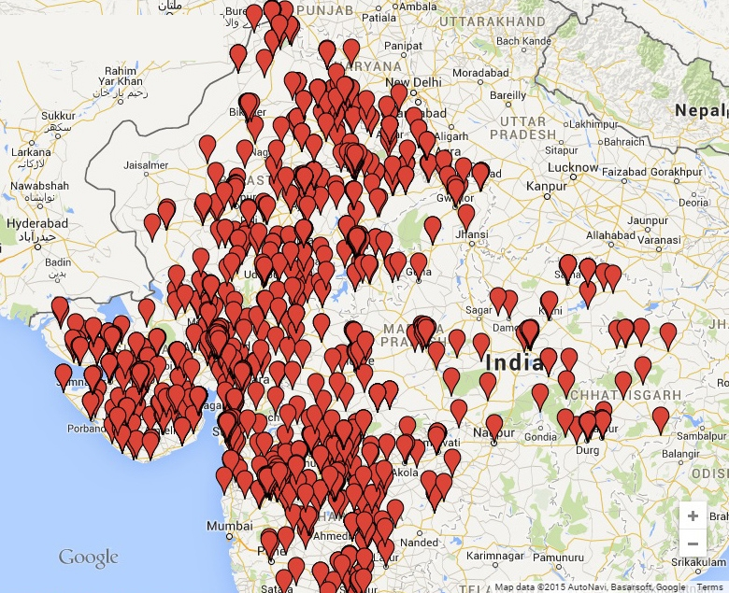
iStreet Bazaar Stores
Haryana | 4 Stores
Rajasthan | 1084 Stores
Gujarat | 615 Stores
MP & CG | 164 Stores
Maharashtra (West) | 653 Stores

Slide 10
FY2015-16 Outlook
Number of Transactions
15 lacs
(FY15 - 0.38 lacs)

Slide 11
FY2015-16 Outlook
Number of iStreet Bazaar Stores
(by end of March 2016)
Over 4,000
(till Sep 2015 – 2,520)

Slide 12
India’s 1st Internet Retail Store

Slide 13
For further information, please contact
iStreet Network Ltd. CIN - L51900MH1986PLC040232 Mrs. Ruchi Seksaria, Company Secretary ruchi@istreetnetwork.com www.istreetnetwork.com

